Slide 1
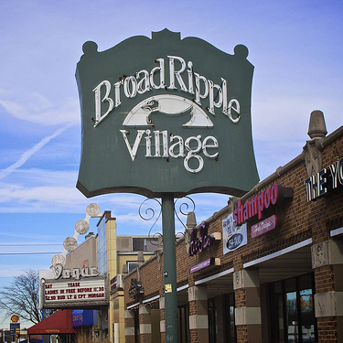
Broad ripple properties
An analysis of 46220

Slide 2

Theme
Visualize and bring to life properties within Broad Ripple from a data perspective using a large data file procured from Indiana State Public Records.

Slide 3

Coding Approach
Secured data
Brainstormed ideas
Settled on html page layout
Determined visualization types
Cleaned the data
Filled in missing information
Divided project

Slide 4
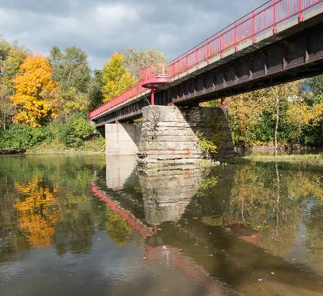
Data Munging Techniques
Reduced file size
Eliminated irrelevant data
Secured coordinates for each property
Merged coordinates with cleaned data

Slide 5
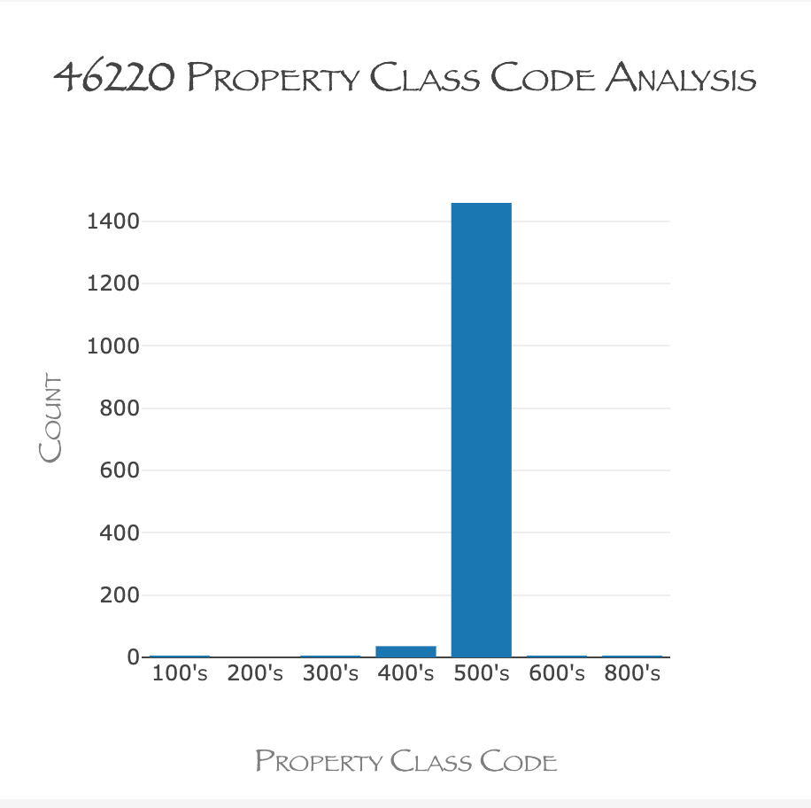
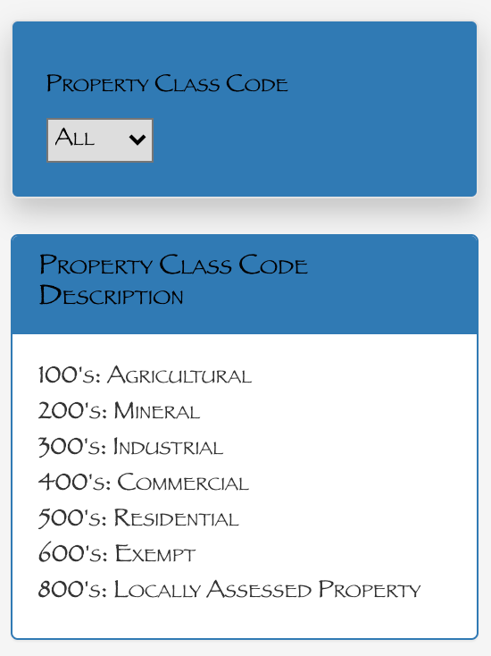
Property code breakdown
Notes:
510: RESIDENTIAL ONE FAMILY DWELLING ON A PLATTED LOT
420: COMMERCIAL SMALL RETAIL
447: COMMERCIAL OFFICE BUILDING 1 OR 2 STORY

Slide 6
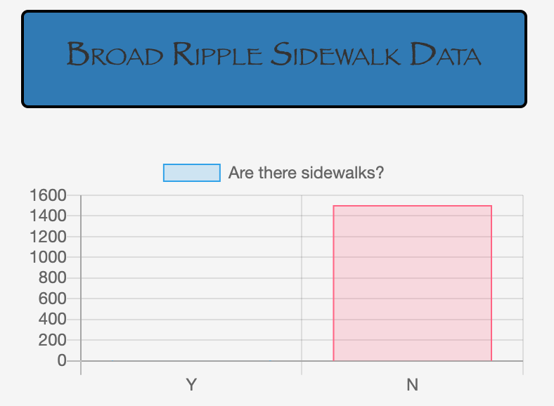
Pedestrian friendly broad ripple
New JS Library
Chart.JS
Lots of functionality to make interactive charts of all kinds
8 chart types
Automatically resizes charts to window size
Easy to use!

Slide 7
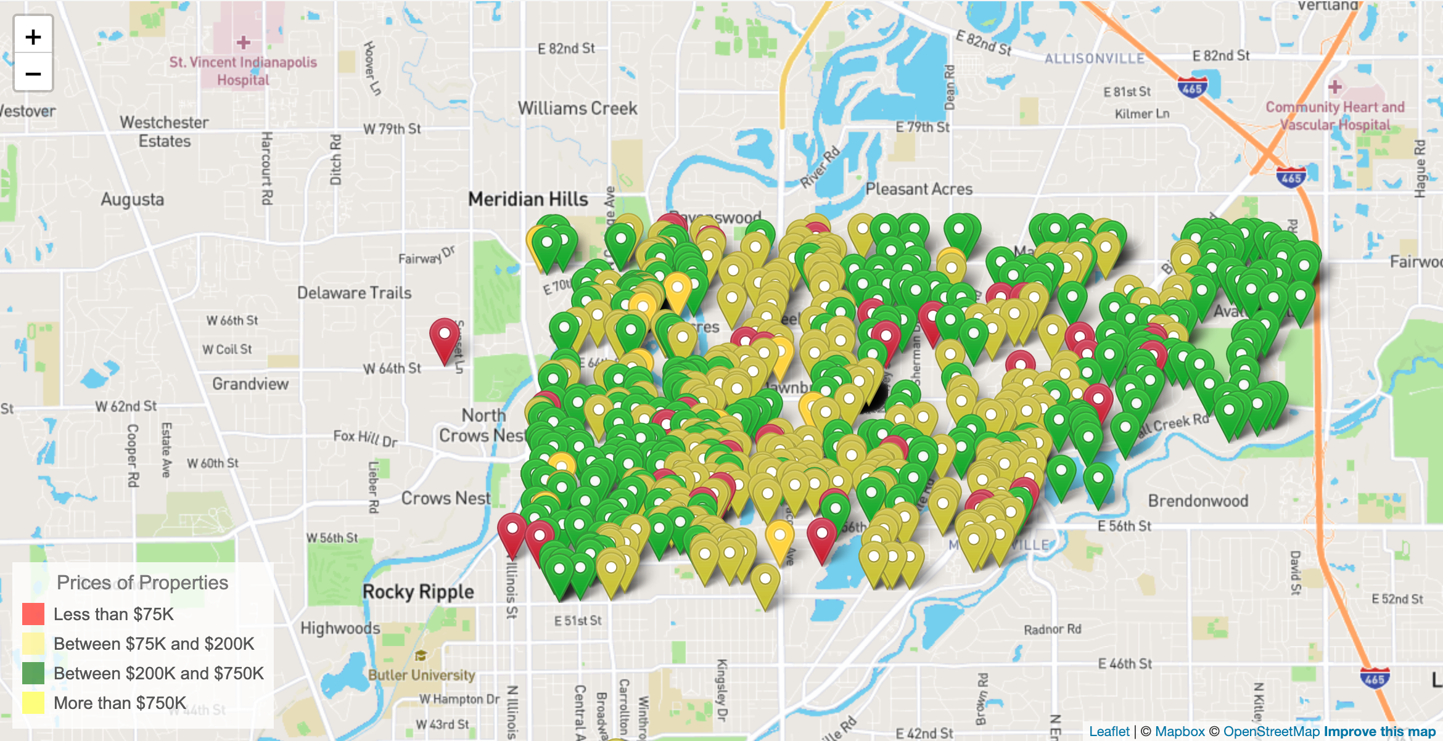
46220 Property listings by value

Slide 8
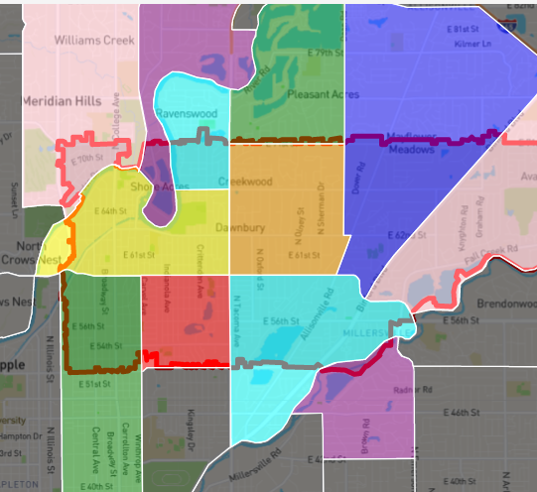
The Neighborhoods of 46220
Broad Ripple
Glendale
Meridian Kessler
Canterbury-Chatard
Allisonville
Devonshire
Millersville
North Central
Meridian Hills/Williams Creek
Ravenswood
Clearwater
I-69/Fall Creek
Devon

Slide 9





Jackson Yaggi
Katie schumann
Data Analyst
Data Analyst
Helena o’farrow
Tim marlett
Nathan prows
Data Analyst
Data Analyst
Data Analyst
Senior member of Group two. You can call me Pops.
9

Slide 10
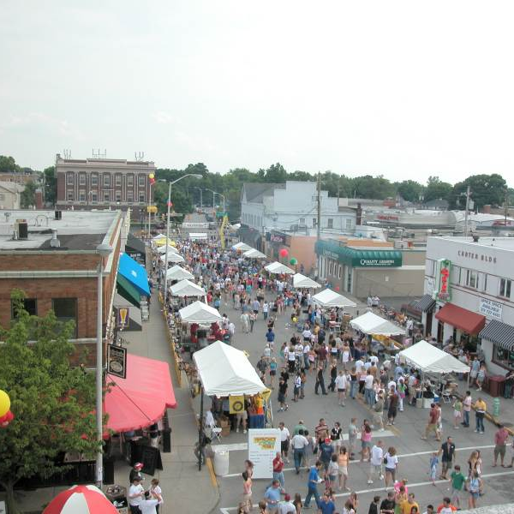
Thank you!
GitHub Repo

